Slide 1
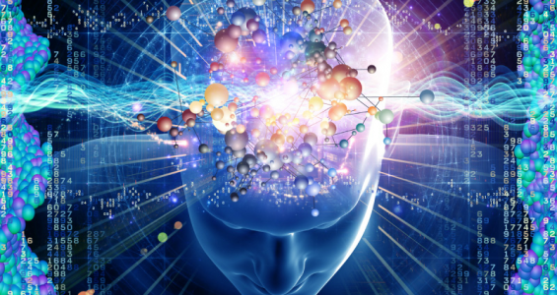
Thinking AND Computation
COMP 4230
David J Stucki
Fall 2024

Slide 2
Alerts
Read the Preface and Chapter 1 of Larson
Find a recent article on artificial intelligence or machine learning in the popular media. Write a 1-2 page essay that (1) summarizes what the article was about, and (2) identifies claims and/or results in the article that are either Harry Potter or Penn & Teller. Make sure that you provide appropriate citation information so that I will be able to find the article. (Due Wednesday 9/4)
WARNING: Today may be initially confusing. There will appear to be contradictory and puzzling claims made. You should spend some time between now and Friday cogitating through these things on your own...
Then ask questions in class!

Slide 3
Einstein, “Hyperbolic Aesthetic” (1937)
Symbolic representation of qualitative entities is doomed to its rightful place of minor importance in a world where flowers and beautiful women abound.

Slide 4
SyMBoLIc
REPRESENTaTIoN
“When some thing is allowed to stand for another”
  What does this mean?
Examples
  Corporate Logos Flags Mathematics
  Road Signs Music Facial Expressions
  Language Mascots Art
    Others?
Every aspect of human culture relies on the power of symbolic representation:
  Communication Education Business/Commerce
  History Government Technology
    Others?
Notes:
Marriott, Shell, Nike, Playboy, Pepsi, Atari
, Toyota, Prudential, AT&T, Plymouth, Adobe
John Deere, McDonalds, United, Honda, Cubs, Yahoo

Slide 5
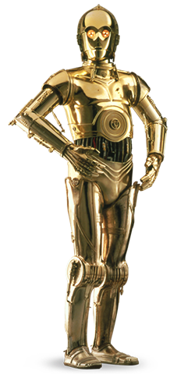

ABSTRacTIoN
A process of simplification that proceeds by
ignoring irrelevant detail while focusing on
what is important
One of the fundamental concepts in
computer science
It is itself a by-product of symbolic representation,
since symbols allow abstraction to take place
A road sign serves only as a compact abstraction of the law

Slide 6
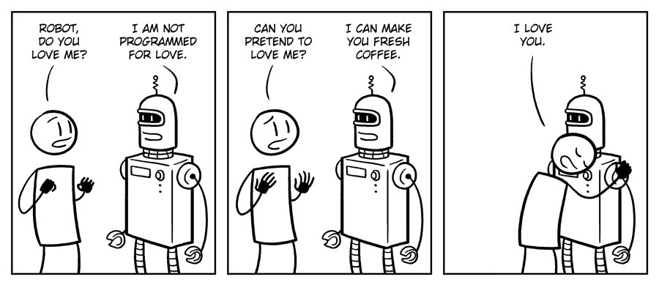
THoUgHT
Without symbolic representation would these be possible?
  Imagination
  Creativity
  Love
  Faith
  Thought
In other words, symbolic representation appears to be central to what it means to be human.
  Or at least necessary...

Slide 7
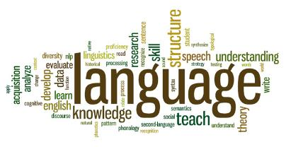
Perhaps the most important, and certainly one of the most sophisticated forms of symbolic representation
  Phonology : Sound, Stress, & Intonation
  Syntax : Structure or Form
  Semantics : Meaning
  Pragmatics : Use or Intention
Since the dawn of recorded history, until the middle of the 20th century, symbolic representation & language have been artifacts of living creatures, most notably humans.
Only recently has this monopoly been broken….

Slide 8
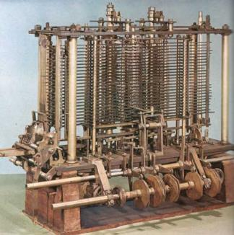
CoMPUTaTIoN
Machines historically have been designed with a specific purpose, which they are then dedicated to for as long as they function.
It wasn’t until Charles Babbage and Ada Lovelace worked on the Analytic Engine in the 1830s that this changed.
The Analytical Engine represents the simultaneous birth
of general purpose computing and programming!
Unfortunately, it would be another 100 years
before Alan Turing would resurrect this idea
Today there are almost as many artificial
computer languages as there are natural
human languages.

Slide 9
THINKING AND COMPUTING
Are computers electronic brains?
Are brains organic computers?
Historically, models of the brain have often been associated with the most advanced technology of the time.
  Clockwork
  Steam Engine
  Telephone Switchboard
Invariably, we end up laughing at these simplistic models!
  Their simplicity yields misleading conclusions
  They have very little explanatory power (i.e., no scientific insight)
Are computers somehow different?

Slide 10
WHAT SORT OF PROCESS IS THINKING?
It is a biological process that happens in the brain.
  Like digestion in the stomach?
  Like mitosis in cells?
The KEY PREMISE of AI is:
  thinking can be usefully understood as a computational process.
In other words, perhaps thinking has more in common with multiplication or sorting a list of names than with digestion or mitosis...?
  THIS IS VERY CONTROVERSIAL!
In order to proceed we need to make sure we understand what is meant by computational process.

Slide 11
THE NATURE OF COMPUTATION
In our next meeting we will cover the origins and history of both computation and AI as by-products of Alan Turing's genius.
For now we will adopt a model of computation based in symbol manipulation
  With a little thought you should be able to convince yourself that every computation is the manipulation of one set of symbols (the input) to produce another set of symbols (output)
A computation then is a process that mechanically follows an algorithm to perform this symbol manipulation
IMPORTANT: A computational process will always be able to be performed by a device or agent without knowing what it is supposed to be calculating

Slide 12
UNTHINKING COMPUTATION
What was that last point?
  When performing a computation you don't need to know what you're doing!
  To get meaningful answers you do not have to understand what the symbols stand for, or why the manipulations are correct.
That is actually the entire point of a computer: mechanical (unthinking) automation of a task. It's one of the most significant innovations of the 20th century.
The media (hardware, etc.) also doesn't matter. Algorithms can be implemented on a dizzying array of platforms, not all of which are electronic.

Slide 13
MAKING SENSE...?
The KEY PREMISE of AI is:
  thinking can be usefully understood as a computational process.
Computational processes are by definition unthinking
Fortunately (or unfortunately?), it isn't that simple. Academics are way too clever to let an apparent contradiction hold them back.
The above PREMISE suggests:
  not that the brain is like a computer (which in some ways it is, but in many it is not)
  but that the process of thinking can be usefully understood as a form of symbol manipulation that can be carried out mechanically without having to know what you are doing

Slide 14
NEXT TIME…
A mathematical diversion...
Alan Turing
The Imitation Game

